Slide 1

Orientation to Computing-I
L T P :2 0 0
www.lpu.in Lovely Professional University

Slide 2

Unit-6 (Profile creation)
Profile creation: Figma, GitHub, Stack overflow, HackerRank, HackerEarth, GeeksforGeeks.
www.lpu.in Lovely Professional University

Slide 3

Activity-1
Create a profile with Figma
Figma is a powerful design tool that helps you to create anything: websites, applications, logos, and much more.
By learning to use Figma, you'll take your first steps into User Interface Design and and User Experience Design.
www.lpu.in Lovely Professional University

Slide 4
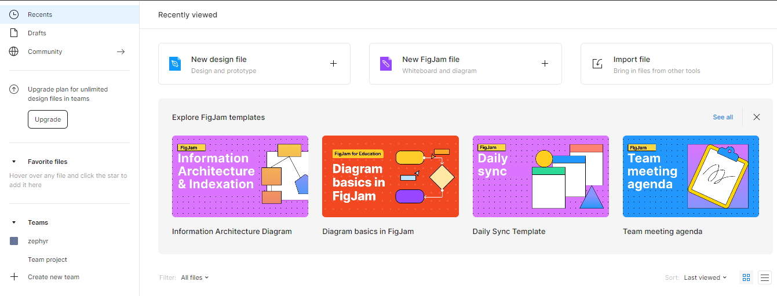
Sign up for a starter pack
www.lpu.in Lovely Professional University

Slide 5
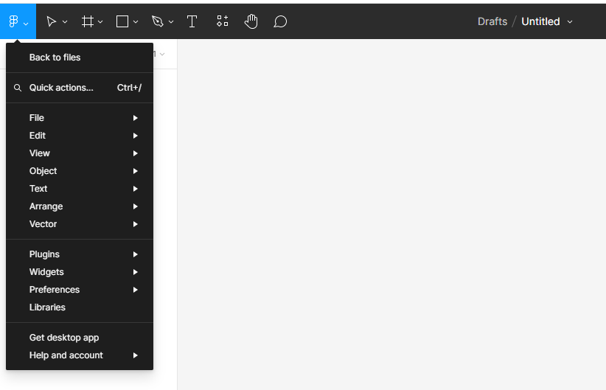
Meet Figma
www.lpu.in Lovely Professional University

Slide 6
Activity - 2
Create profile on
  StackOverflow
  Hackerrank
  Hackerearth
  GeeksforGeeks
Explore Interface
www.lpu.in Lovely Professional University

Slide 7
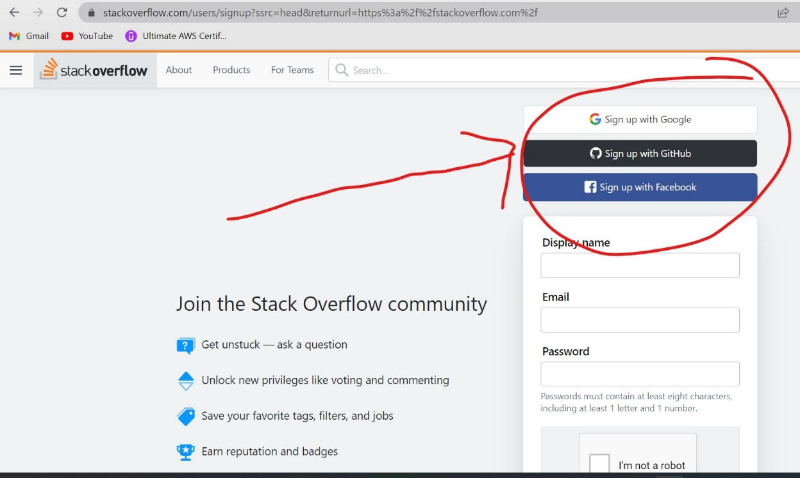
Stackoverflow
https://stackoverflow.com/
www.lpu.in Lovely Professional University

Slide 8
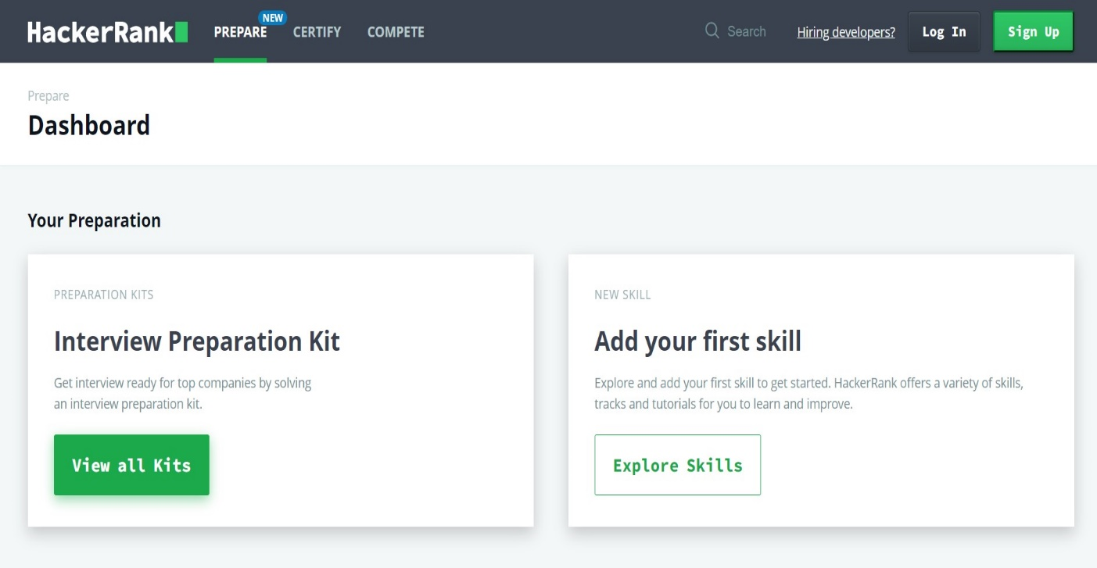
Hackerrank
https://www.hackerrank.com/dashboard
www.lpu.in Lovely Professional University

Slide 9
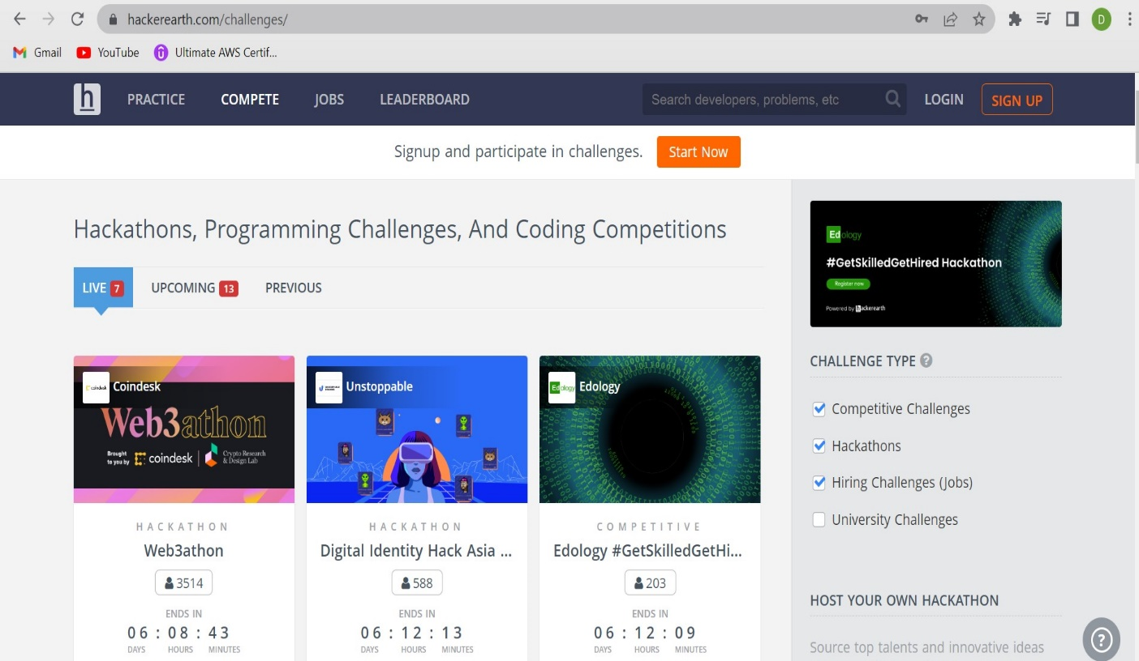
Hackerearth
https://www.hackerearth.com/
www.lpu.in Lovely Professional University

Slide 10
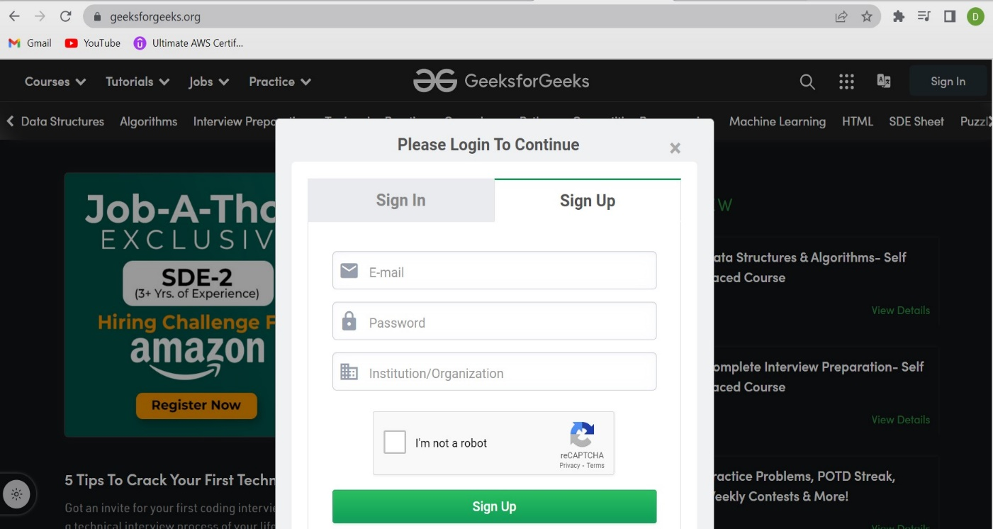
GeeksforGeeks
https://www.geeksforgeeks.org/
www.lpu.in Lovely Professional University

Slide 11
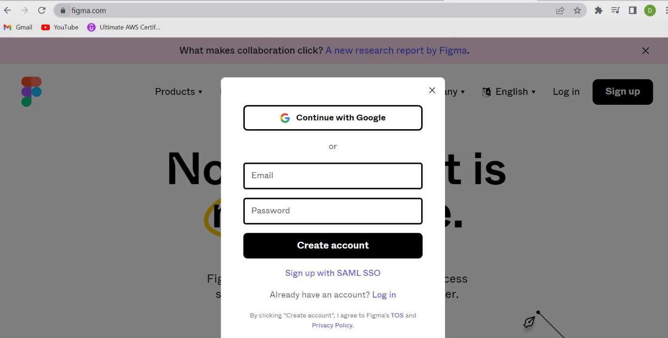
Figma
https://www.figma.com/
www.lpu.in Lovely Professional University

